Slide 1
ISPARTA
SÜLEYMAN DEMİREL UNIVERSITY
&
MEVLANA Exchange Program
ISPARTA/ TÜRKİYE
A University that inspires…

Slide 2
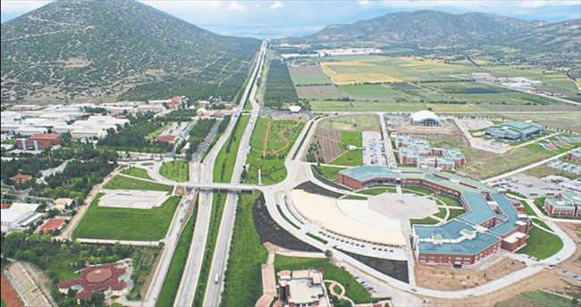
SULEYMAN DEMIREL UNIVERSITY
SDU was founded as a state university in 1992 and named after the nineth president of Turkey.
15 Faculties
2 Colleges
4 Vocational Schools
6 Graduate Schools
46 Research Centers
Nearly 41747 students and 1700 academic staff.

Slide 3
FACULTIES IN SDU
Faculty of Dentistry
Faculty of Art and Sciences
Faculty of Fine Arts
Faculty of Economics and Administrative Sciences
Faculty of Engineering
Faculty of Architectures
Faculty of Education
Faculty of Divinity
Faculty of Technical Education
Faculty of Medicine
Faculty of Health Sciences
Faculty of Law
Faculty of Communication
Faculty of Pharmacy
Faculty of Sport Sciences

Slide 4
ACCOMODATION IN SDU
Incoming students can accomodate in private student apartments, Çiftçi Eğitim Merkezi in Central Campus or in private dormitory.
Incoming academic staff can accomodate in University guest house located in University and city center.
Programme does not pay for the accomodation expenses.

Slide 5
WHO IS MEVLANA?
Mevlana has not make any discrimination between people as indicated in his verse “Come, come whoever you are.
UNESCO, due to the 800th anniversary of Mevlana’s birth, declared the year 2007 as Mevlana and Tolerance year.
Mevlana attributed great importance to “change” in his philosophy throughout his life
He is also the author of the important works like Masnavi, Divan-ı Kebir, Fihi Mafih, Mektubat and Mecalis-i Seba.

Slide 6
Mevlana Exchange Programme is a programme which aims the exchange of students and academic staff between the Turkish Higher Education institutions and Higher Education institutions of other countries.
MEVLANA EXCHANGE PROGRAMME

Slide 7
DIFFERENCE WITH OTHER
PROGRAMMES:
Offer the opportunity of studying or teaching in any University in the world.
There isn’t any geographical boundaries.
Opportunity of non-refundable grant.
Mevlana Exchange Programme includes 65 countries.
The participants of Mevlana Exchange programme can also participate in other Exchange programmes.

Slide 8
MEVLANA EXCHANGE PROGRAMME BILATERAL AGREEMENT
A valid bilateral agreement is required for student and academic staff exchange.
The bilateral agreements is valid for five years.
The institutes can make an additional Protocol to indicate the responsibility of foreign universities.
Suleyman Demirel University has 27 bilateral agreements with 15 different countries.
Suleyman Demirel University has 727 incoming students and 427 incoming academic staff quota.
Suleyman Demirel University Mevlana Office and its voluntary students help our incoming students and academic staff.

Slide 9
EXCHANGE OF STUDENTS
The students registered to the following programs of the universities which have bilateral agreement can benefit from Mevlana Exchange Programme
Vocational schools (2nd class)
Bachelor’s degree (2nd, 3rd, 4th classes)
Master, doctorate programme (after the first semester excluding the language or scientific preparation semesters)
Mevlana Değişim Programı Kurum Koordinatörlüğü

Slide 10
EXCHANGE OF STUDENTS
Turkish citizen students who study in foreign university unfortunately couldn’t apply to Mevlana Exchange programme.
Foreign students of Turkish universities couldn’t apply to universities in their countries.
For the offered courses, please visit SDU International Office or Mevlana websites.

Slide 11
CIRCUMSTANCES TO BE A MEVLANA EXCHANGE STUDENT
Grade Point Average (GPA) Should Be At Least:
2.5/4.0 for the students vocational schools and bachelor’s degree
3.0/4.0 for the Ms and PhD students
The score of language of which the host institute use for teaching
Mevlana Exchange Score: : 0.5*Language Score + 0.5* GPA.

Slide 12
23.01.2019 THE COUNCIL OF HIGHER EDUCATION EXECUTIVE COUNCIL DECISIONS It has decided as follows in compliance with the specificied area as student (incoming / outgoing) and academic staff exchange with the countries listed below.
COUNTRY | AREA | COUNTRY | AREA
Afghanistan | Social and Human Sciences | Brazil | Engineering and Physical Sciences
Albania | Social and Human Sciences | Burundi | Engineering and Physical Sciences+Social and Human Sciences+Health Sciences
Algeria | Social and Human Sciences | Canada | Engineering and Physical Sciences +Health Sciences
Australia | Engineering and Physical Sciences + Health Sciences | Chad | Engineering and Physical Sciences+Health Sciences+Social and Human Sciences
Azerbaijan | Social and Human Sciences+Engineering and Physical Sciences+ Health Sciences | China | Engineering and Physical Sciences +Health Sciences
Bangladesh | Social and Human Sciences | Colombia | Engineering and Physical Sciences
Belarus | Engineering and Physical Sciences | Djibouti | Social and Human Sciences
Bosnia-Herzegovina | Social and Human Sciences | Egypt | Social and Human Sciences

Slide 13
COUNTRY | AREA | COUNTRY | AREA
England | Engineering and Physical Sciences +Health Sciences +Social and Human Sciences | Kyrgyzstan | Social and Human Sciences
France | Engineering and Physical Sciences +Health Sciences +Social and Human Sciences | Libya | Social and Human Sciences
Gambia | Social and Human Sciences | Lebanon | Social and Human Sciences
Georgia | Social and Human Sciences+Engineering and Physical Sciences+Health Sciences | Macedonia | Social and Human Sciences
India | Engineering and Physical Sciences +Health Sciences +Social and Human Sciences | Malaysia | Engineering and Physical Sciences+Social and Human Sciences
Indonesia | Engineering and Physical Sciences | Mexico | Engineering and Physical Sciences
Iran | Engineering and Physical Sciences | Mongolia | Social and Human Sciences
Iraq | Social and Human Sciences | Montenegro | Engineering and Physical Sciences +Social and Human Sciences
Japan | Engineering and Physical Sciences +Health Sciences +Social and Human Sciences | Morocco | Social and Human Sciences+Engineering and Physical Sciences
Jordan | Social and Human Sciences | New Zealand | Engineering and Physical Sciences
Kazakhstan | Social and Human Sciences+Engineering and Physical Sciences | Niger | Engineering and Physical Sciences+Social and Human Sciences
Kosova | Social and Human Sciences | Oman | Engineering and Physical Sciences +Social and Human Sciences
Kuwait | Engineering and Physical Sciences+Social and Human Sciences

Slide 14
COUNTRY | AREA | COUNTRY | AREA
Philippines | Engineering and Physical Sciences | Tajikistan | Social and Human Sciences
Pakistan | Social and Human Sciences+Engineering and Physical Sciences | Thailand | Engineering and Physical Sciences
Palestine | Social and Human Sciences | Tunis | Social and Human Sciences+Engineering and Physical Sciences
Qatar | Engineering and Physical Sciences +Social and Human Sciences | Turkmenistan | Social and Human Sciences
Romania | Engineering+Social and Human Sciences | Uganda | Engineering and Physical Sciences+ Social and Human Sciences
Russia | Engineering and Physical Sciences +Social and Human Sciences | Ukraine | Social and Human Sciences+Engineering and Physical Sciences
Rwanda | Engineering and Physical Sciences+Social and Human Sciences+Health Sciences | USA | Engineering and Physical Sciences +Health Sciences
Saudi Arabia | Engineering and Physical Sciences + Social and Human Sciences | Uzbekistan | Social and Human Sciences
Singapore | Engineering and Physical Sciences | Yemen | Social and Human Sciences
Somalia | Engineering and Physical Sciences+Social and Human Sciences+Health Sciences | Zambia | Engineering and Physical Sciences+Social and Human Sciences+Health Sciences
South Africa | Engineering and Physical Sciences
South Korea | Engineering and Physical Sciences +Health Sciences +Social and Human Sciences
Spain | Engineering and Physical Sciences +Social and Human Sciences
South Sudan | Engineering and Physical Sciences+Social and Human Sciences+Health Sciences
Sudan | Social and Human Sciences

Slide 15
MEVLANA PARTNER UNIVERSITIES
1- Al Al-Bayt University (Jordan)
2- Universiti Sains Islam Malaysia
3- Odlar Yurdu University (Azerbaijan)
4- Syiah Kuala University (Indonesia)
5- International Islamic University (Malaysia)
6- International University of Sarajevo (Bosnia-Herzegovina)
7- Ahmet Yesevi University (Kazakstan)
8- Osh State University (Kyrgyzstan)

Slide 16
MEVLANA PARTNER UNIVERSITIES
9- University of Selangor
10- University of Putra Malaysia
11- Ibn Tofail University (Morocco)
12- Manas University (Kyrgyzstan)
13- Azerbaijan State Economic University
14- Institut Teknologi Sepuluh Nopember
15- Caucasus International University (Georgia)
16- L.N. Gumilyov Eurasian National University (Kazakstan)
17-Kazakh National Agrarian University
18- Nizhyn State University
19- Bukhara Medical Institute
20- Dongduk Women’s University
21- Manarat International University
22- Asian University of Bangladesh
23- Sousse University (Tunisia)
24- Tunis El Manar University (Tunisia)
25- Kairouan University (Tunisia)
26- Sfax University (Tunisia)
27- University of Sarajevo (Bosnia-Herzegovina)

Slide 17
STUDENT DOCUMENTS
Candidate Students
Candidate Application Form
Transcript
Certificate of Language
After The Confirmation
Application Form
Learning Agreement
Letter of Acceptance
Arrival Form
Student Declaration
Information Form
Before Leaving SDU
Student Final Report
Student Declaration of Attendance
Activity Report (for graduate students)
Documents are avilable here : http://mevlana.sdu.edu.tr/en/dokumanlar/student

Slide 18
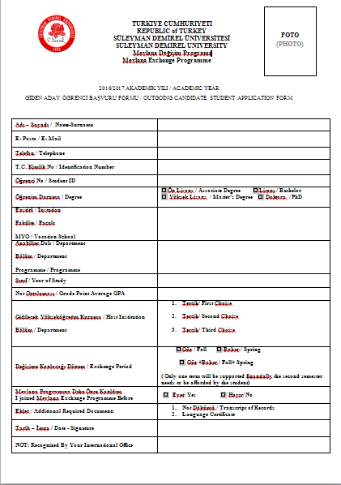

Slide 19
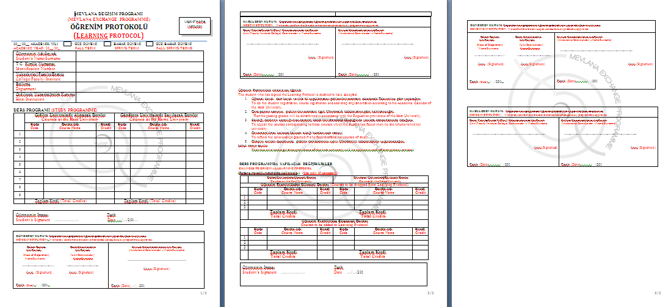

Slide 20
RESIDENT PERMIT
Incoming student should apply for his/her resident permit in a month after his/her arrival in Turkey.
Incoming students should bring their insurance documents with them. (The insurance should be valid in Turkey otherwise, they will pay approx. 600 TL for a new insurance.)

Slide 21
Documents Asked for Student Residence Permit
Online Application Form
Original copy and photocopy of the passport or travel document
Four Photos
Valid Health Insurance
Mevlana Student Certificate
Document showing your adress information
Residence Permit Card Fee Receipt
Income Statement

Slide 22
EDUCATIONAL EXPENCES
During the exchange mobility, the participant students must pay the required tuition fee to their home higher educational institute.
During the exchange mobility, the participant students don’t pay any tuition fee to the host university.

Slide 23
EXCHANGE OF ACADEMIC STAFF
Academic staff (professor, associate professor, assistant professor, lecturer) can participate to Mevlana Exchange Programme.
Research assistants could only participate to Mevlana Exchange Programme as a student not as an academic staff.
Academic staff should lecture at least 6 hours per a week.
Academic staff can participate Mevlana programme min. 14 days and max. 3 months.

Slide 24
DOCUMENTS FOR ACADEMIC STAFF
Candidate Academic Staff
Candidate Application form
CV, Annex
Certificate of Language
After The Confirmation
Academic Staff Mobility Programme
Letter of Acceptance
Academic Staff Declaration
Information Form
Before Leaving SDU
Academic Staff Final Report
Academic Staff Declaration of Attendance

Slide 25
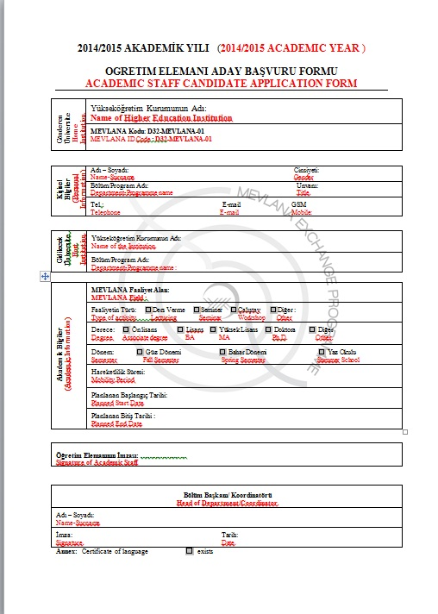

Slide 26
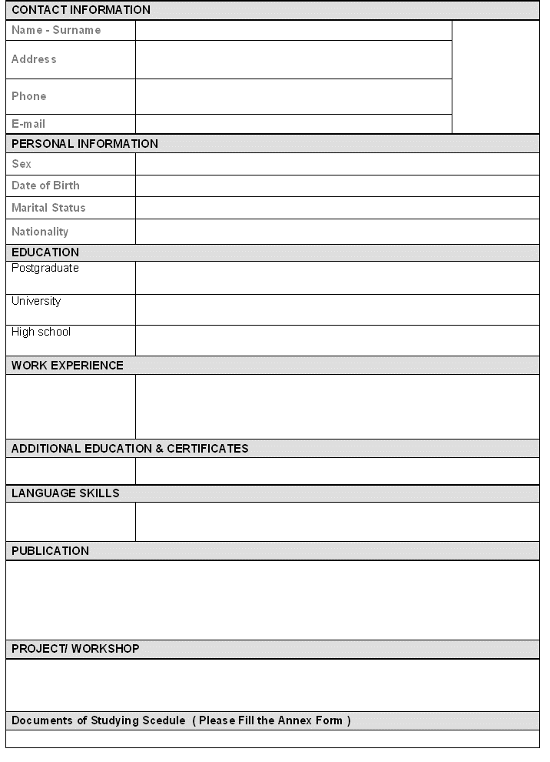
CV

Slide 27
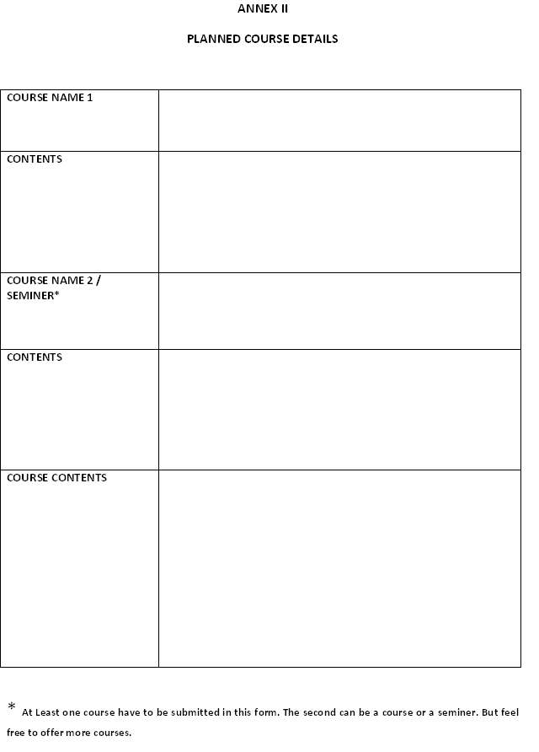

Slide 28
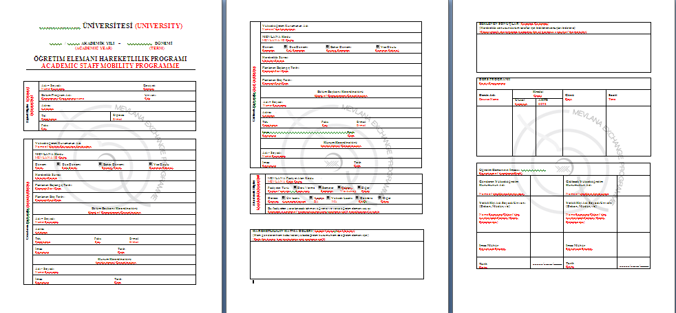

Slide 29
MEVLANA ACADEMIC CALENDAR
Application Dates | To be announced by The Council of Higher Education (Usually between February and March, each year)
Sending the assessment of incoming students and academic staff to SDU Mevlana Office | To be announced by The Council of Higher Education (Usually between February and March, each year)

Slide 30
DURATION OF EXCHANGE:
Student
Minimum 1, maximum 2 semesters (4 months with scholarship +1 semester without scholarship)
Couldn’t exceed one academic year
Academic Staff
Minimum 14 days
Maximum 3 months

Slide 31
Finantial Supports
For 2018-2019 Academic Year | PAYMENT (month/day) | TRAVEL PAYMENT (MAX)
INCOMING STUDENTS * | 1200 TL (per month) | -
INCOMING ACADEMIC STAFF | ~40 - 50 TL (per day) | 3000-4500TL
80% of the scholarship is paid to students in a month after their arrival to SDU. The rest of the scholarship will be paid based on the ratio of total credits of the succeeded courses to the courses that the student is obliged to take. The scholarship includes only for four months.

Slide 32
PAYEMENT FOR ACADEMIC STAFF INCOMING (2019-2020)
Daily Wage
Professor | 50,00 TL
Associate Professor | 50,00TL
Assistant Professor | 50,00 TL
Lecturer | 40,00 TL

Slide 33
TRAVEL EXPENSES
COUNTRIES | PAYEMENT (MAX)
Azerbaijan | 3000 TL
Bosnia-Herzegovina | 3000 TL
Kazakstan | 3500 TL
Kyrgyztan | 3500 TL
Malaysia | 4500 TL
Indonesia | 4500 TL
Georgia | 3000 TL
Jordan | 3000 TL
Palestine | 3000 TL
Russia | 3000 TL
Ukraine | 3000 TL
South Korea | 4500 TL
Tunis | 3000 TL

Slide 34
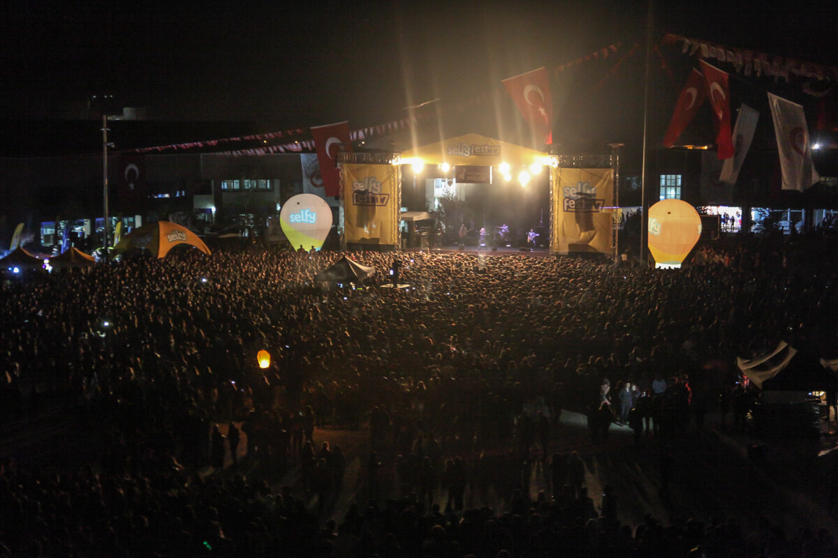
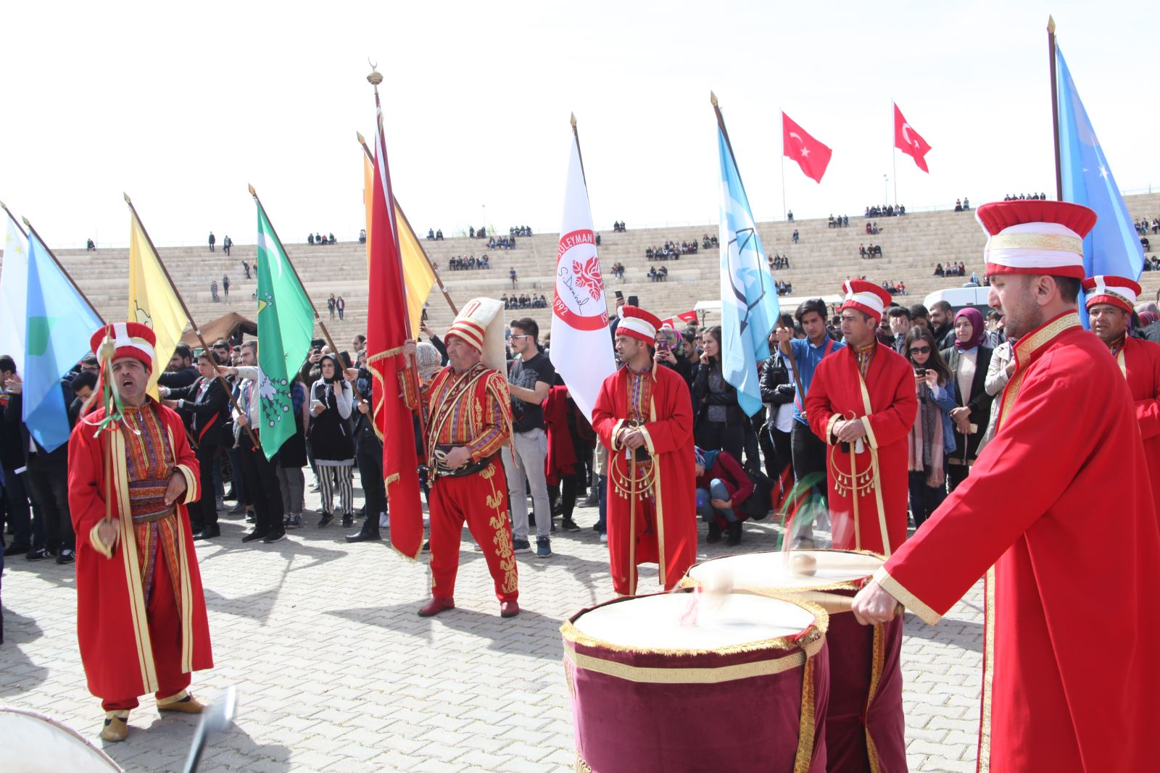
SOCIAL
ACTIVITIES

Slide 35
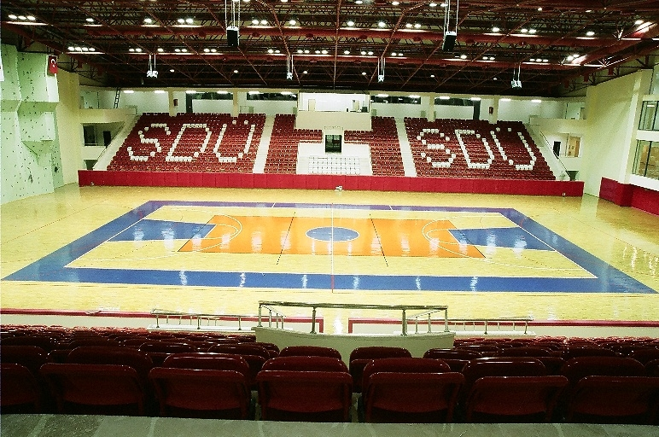
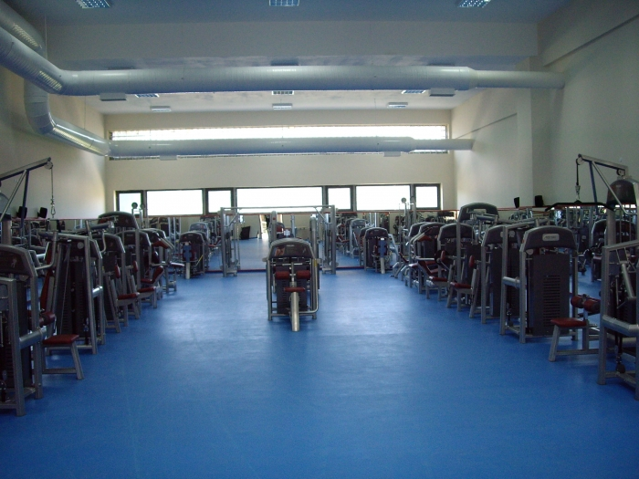
SDU ATATÜRK SPORTS CENTER

Slide 36
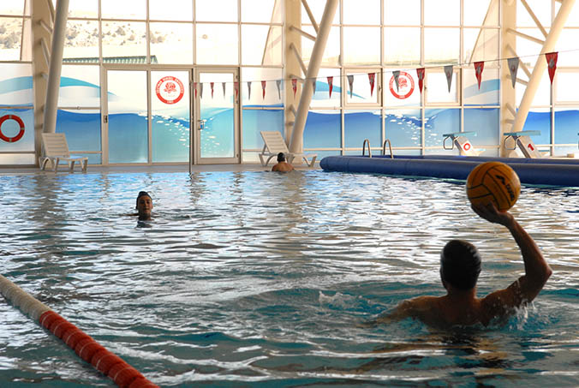
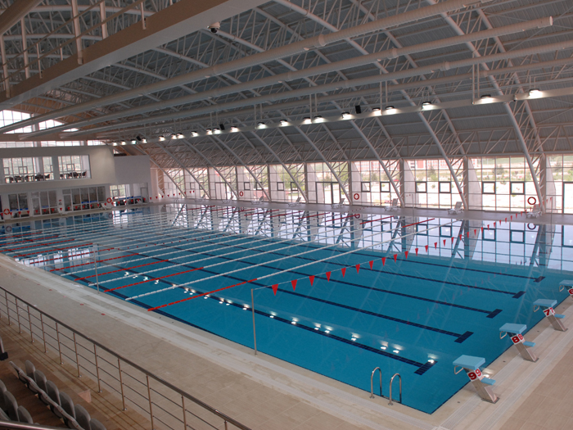
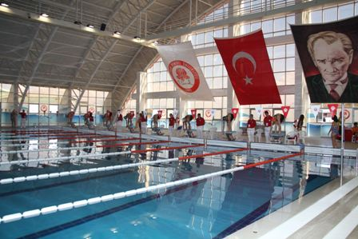
29 EKİM OLYMPIC POOL

Slide 37
1283 International Students at SDU in 2018

Slide 38
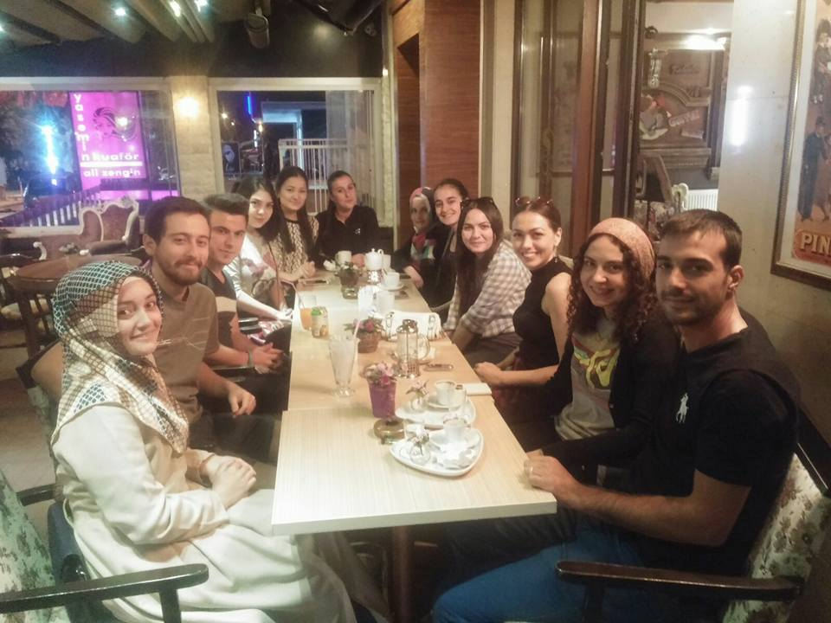
MEVLANA INCOMING STUDENTS

Slide 39
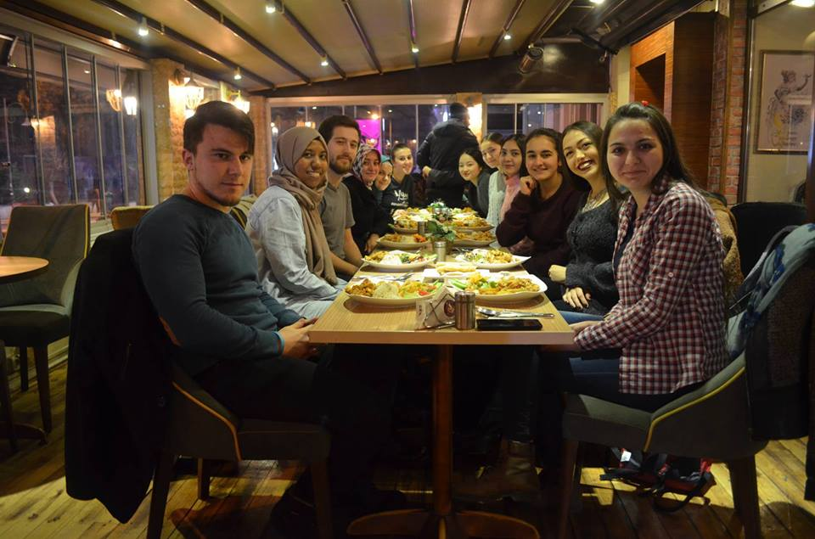

Slide 40
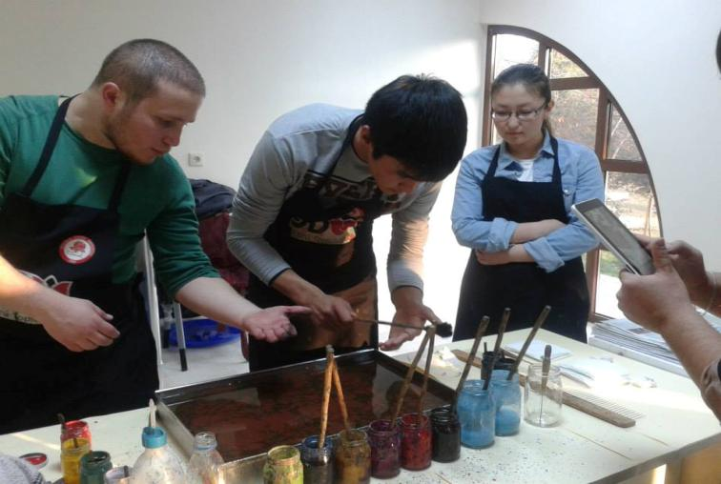
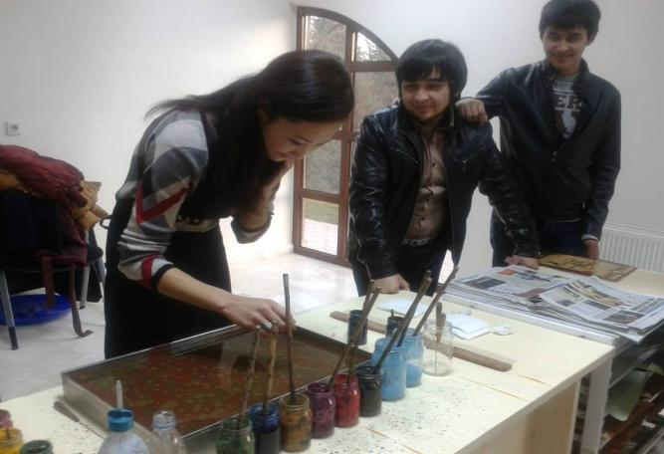
Marbling Art

Slide 41
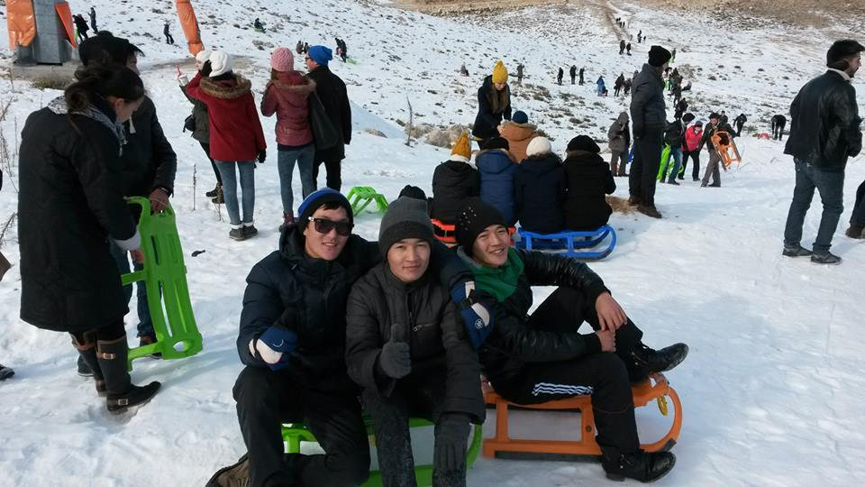
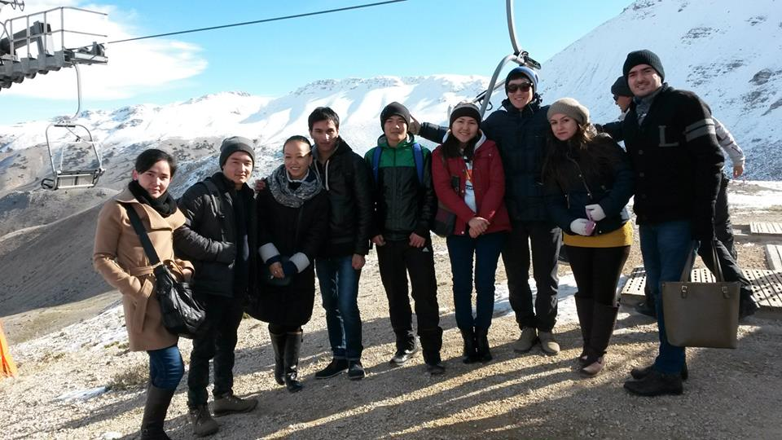
VISIT OF DAVRAZ

Slide 42
EĞİRDİR

Slide 43
FOR MORE INFORMATION AND THE DOCUMENTS
Web Adres: http: mevlana.sdu.edu.tr
E-mail: mevlana@sdu.edu.tr
Phone: 00 90 246 211 82 76 – 77

